Slide 1
Udacity Connect Session
Session 10

Slide 2
Content
Intro To Machine Learning
Linear Regression
Gradient Descent
Linear Regression vs Logistic Regression

Slide 3
Intro To Machine Learning

Slide 4
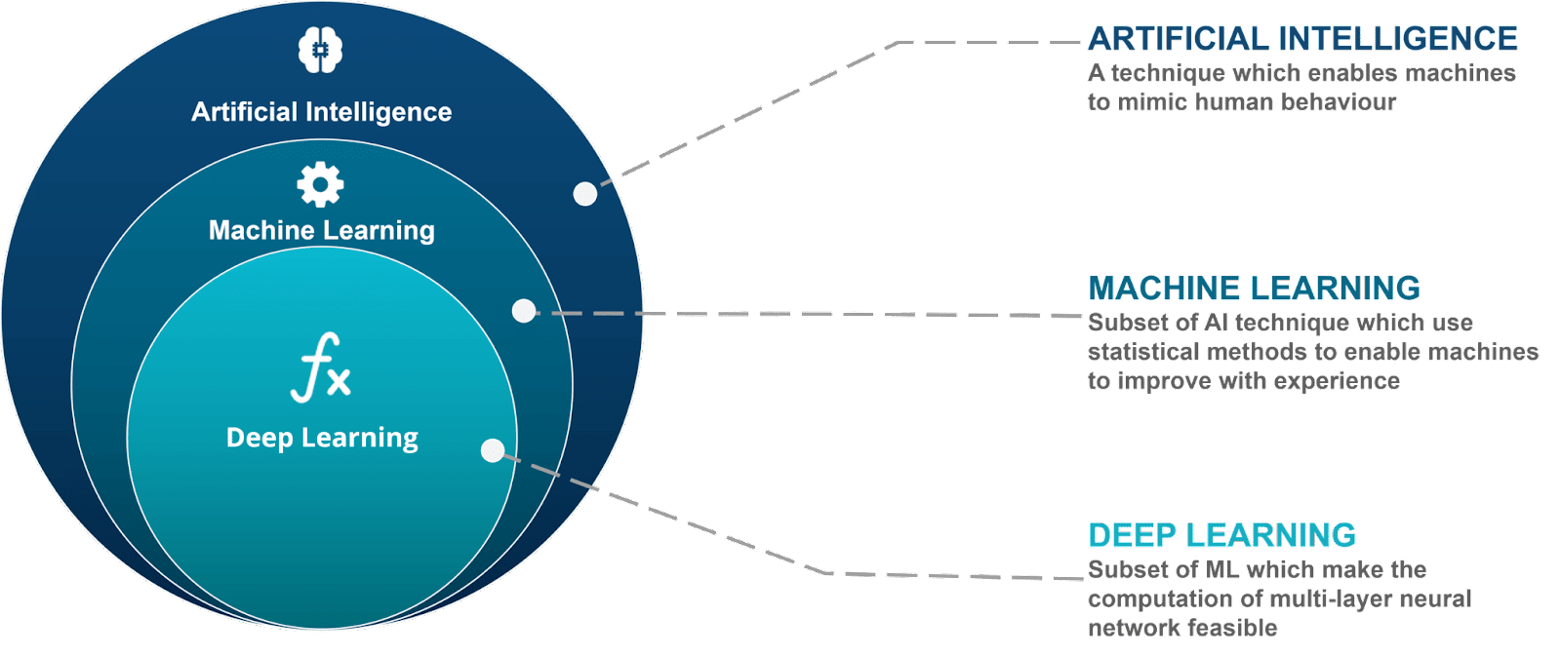
Intro To Machine Learning

Slide 5
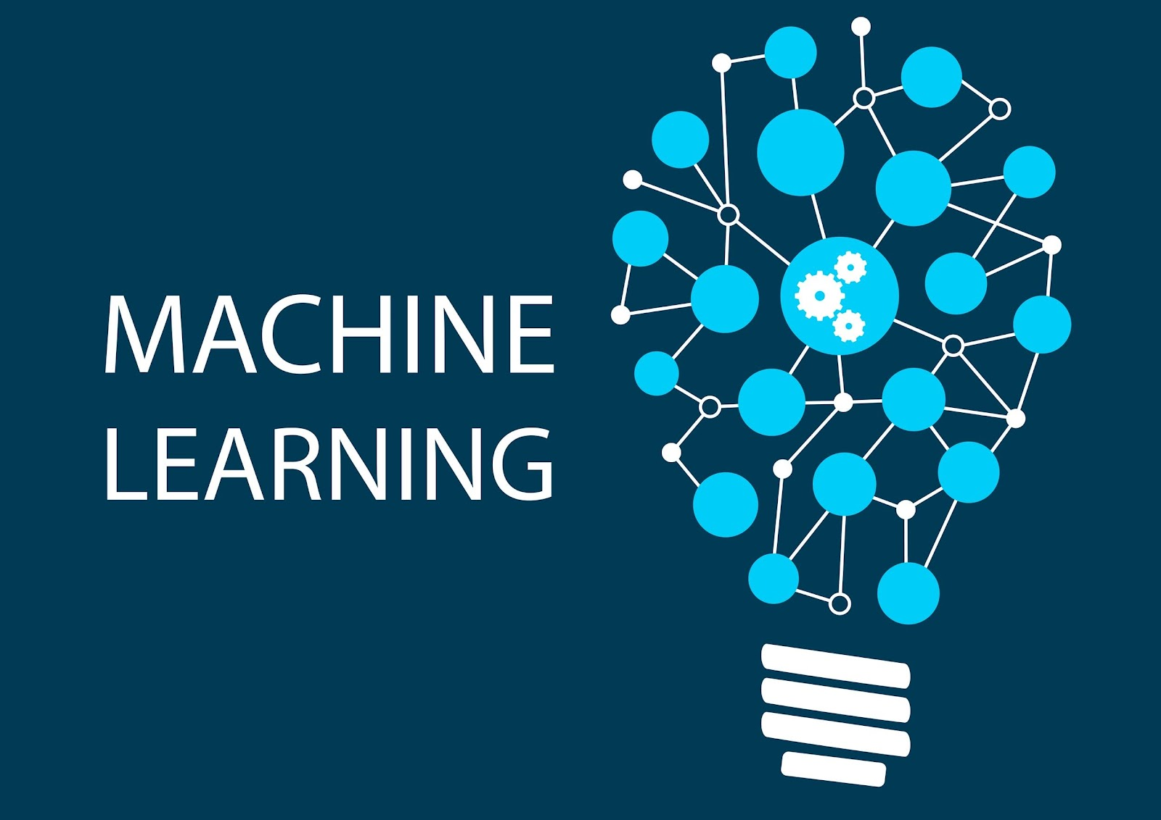
Intro To Machine Learning
Machine learning is an application of artificial intelligence (AI) that provides systems the ability to automatically learn and improve from experience without being explicitly programmed

Slide 6
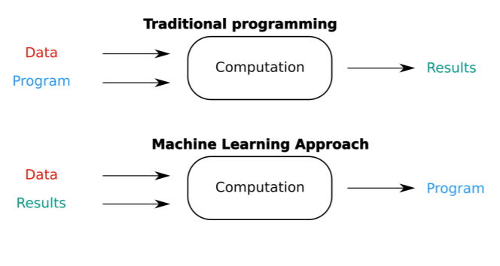
Intro To Machine Learning

Slide 7
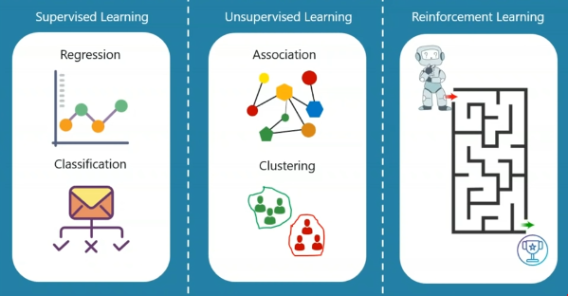
Intro To Machine Learning
1) Supervised Learning
1.1) Regression
1.2) Classification
2) Unsupervised Learning
2.1) Clustering
2.2) Association
3) Reinforcement Learning

Slide 8
Linear Regression

Slide 9
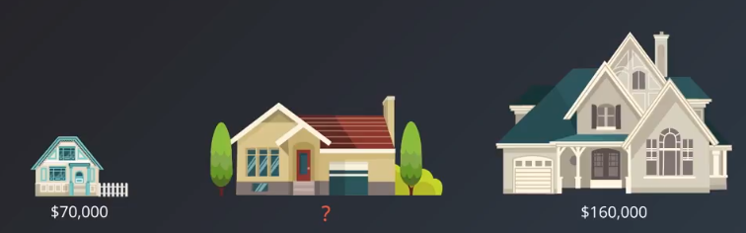
Linear Regression
Let’s say we want to estimate the price of the medium sized house
What do we do?

Slide 10
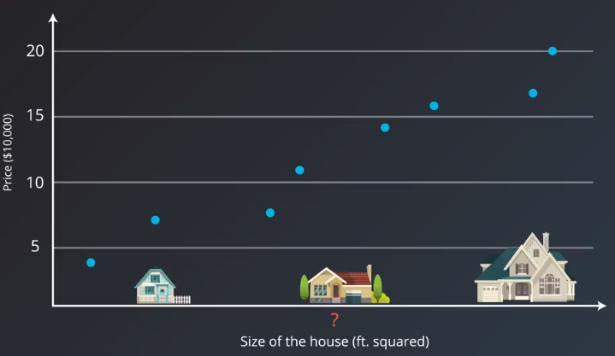
Linear Regression

Slide 11
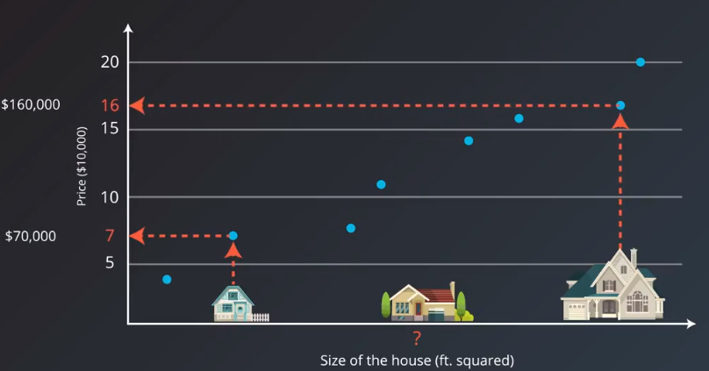
Linear Regression

Slide 12
Linear Regression

Slide 13
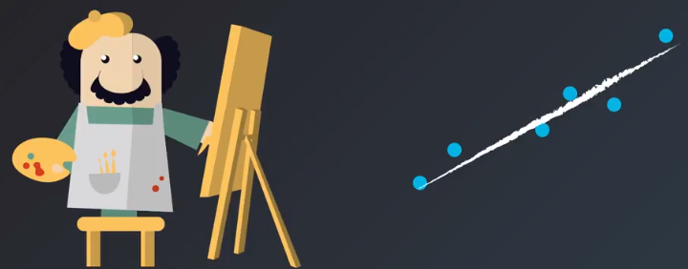
Linear Regression
You can think of Linear Regression as a painter drawing best fit line through your data

Slide 14
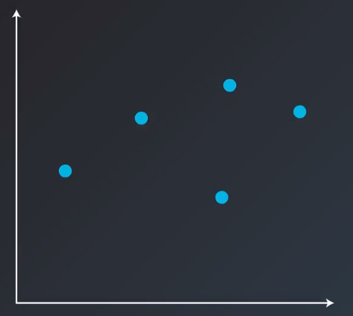
Linear Regression
Now how do we find that line?

Slide 15
Linear Regression
Now how do we find that line?

Slide 16
Linear Regression
Now how do we find that line?

Slide 17
Linear Regression
Now how do we find that line?

Slide 18
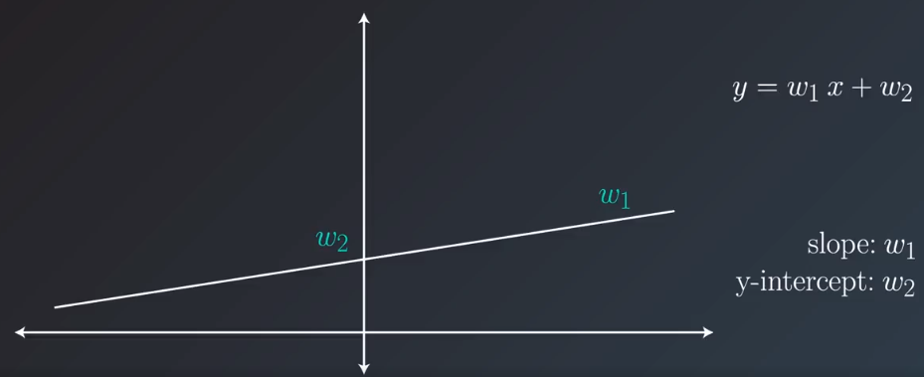
Linear Regression
Now…
How do we move that line (in mathematical terms)

Slide 19
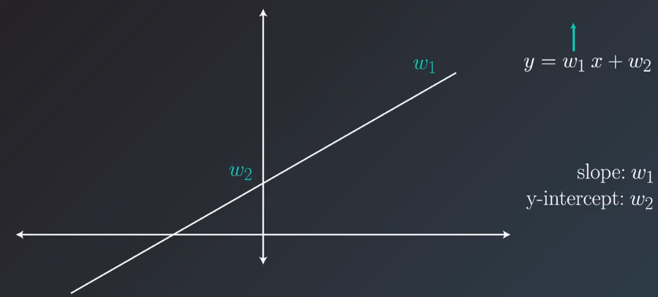
Linear Regression
Increase the slope (w1)

Slide 20
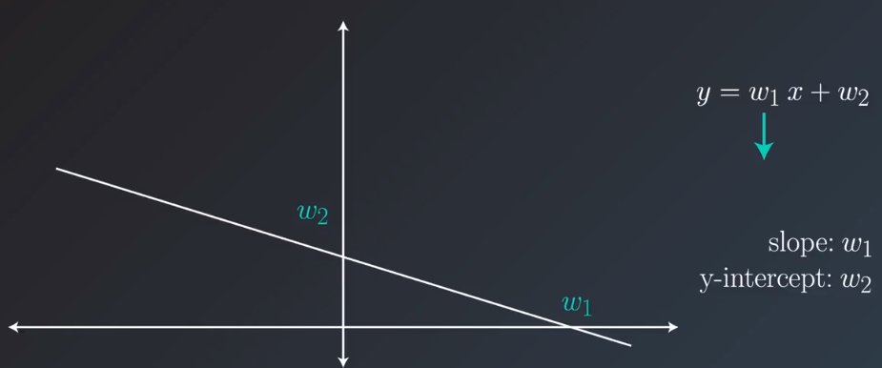
Linear Regression
Decrease the slope (w1)

Slide 21
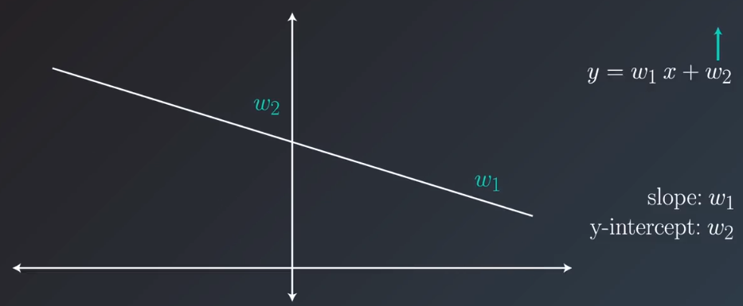
Linear Regression
Increase y-intercept (w2)

Slide 22
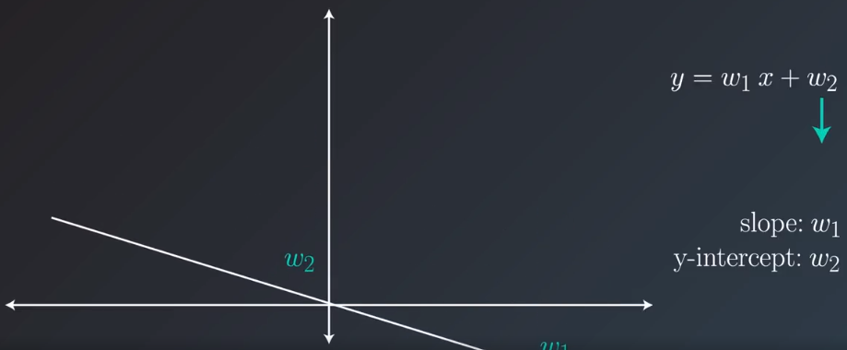
Linear Regression
Decrease y-intercept (w2)

Slide 23
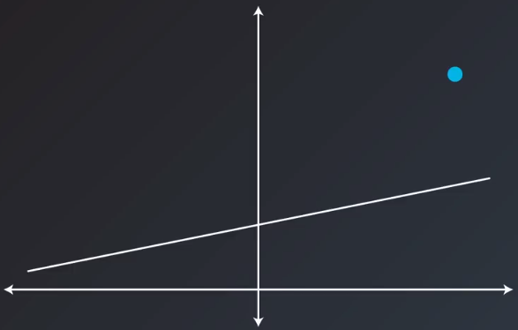
Linear Regression
Now that we know how to move the line.
Its time to move the line towards the point

Slide 24
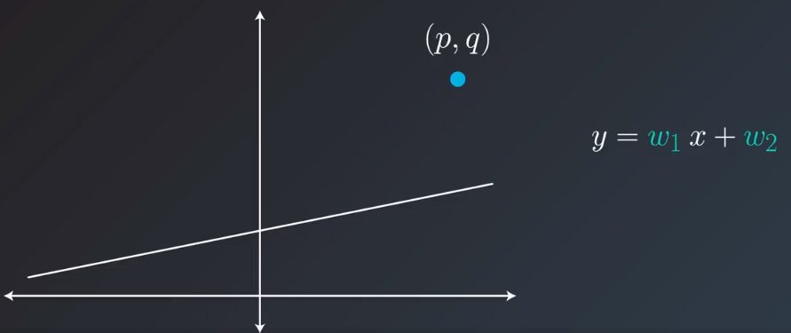
Linear Regression

Slide 25
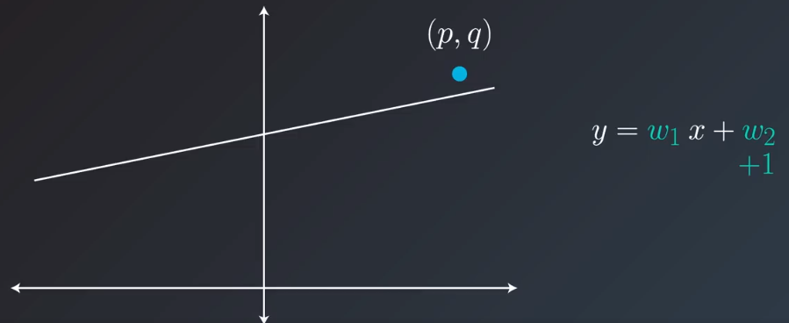
Linear Regression

Slide 26
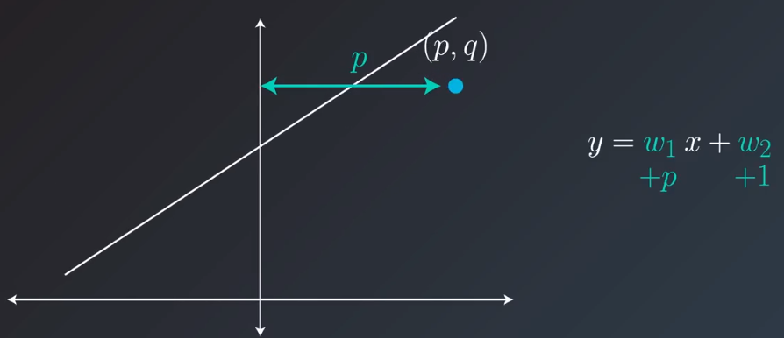
Linear Regression

Slide 27
Linear Regression

Slide 28
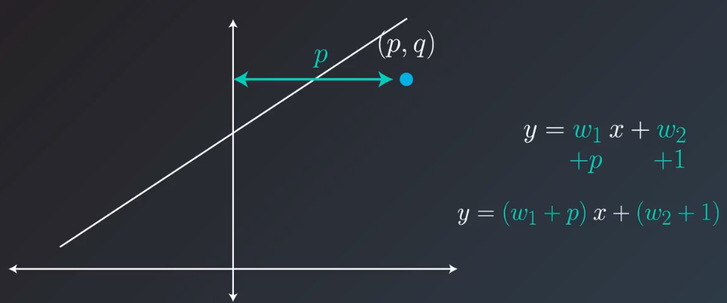
Linear Regression

Slide 29
Linear Regression
We successfully moved the line towards the point.
Notice however that we moved the line too much. And the line has now moved past the point
We don’t like to do that in machine learning. So we have to take smaller steps

Slide 30
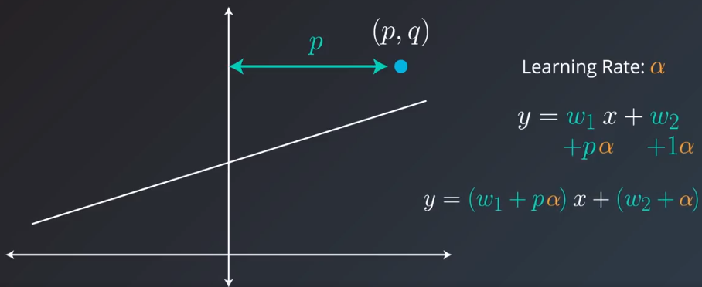
Linear Regression

Slide 31
Gradient Descent

Slide 32
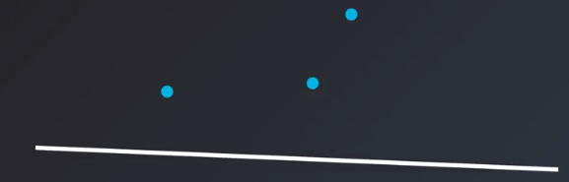
Gradient Descent

Slide 33
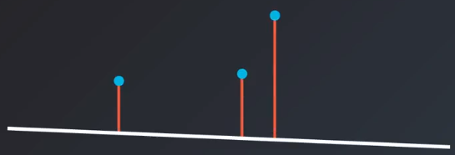

Gradient Descent

Slide 34
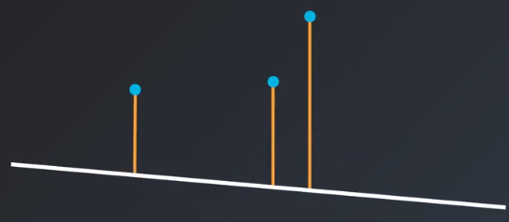
Gradient Descent

Slide 35

Gradient Descent

Slide 36
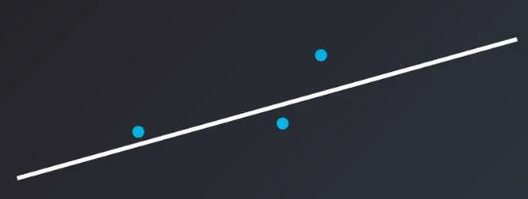
Gradient Descent

Slide 37
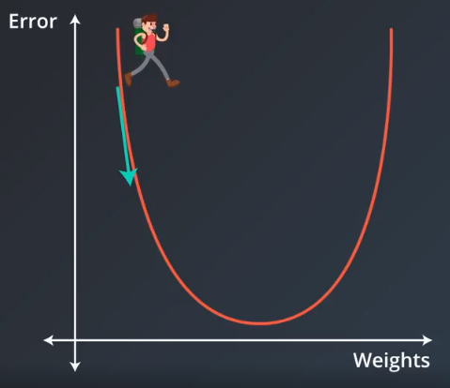
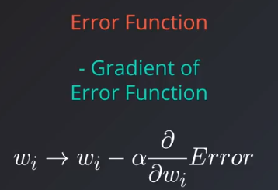
Gradient Descent

Slide 38
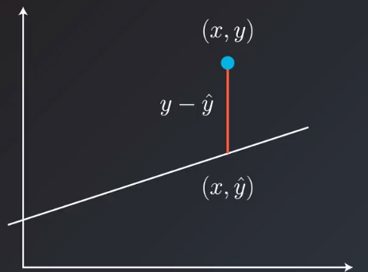
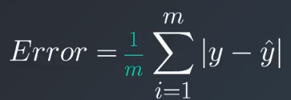
Gradient Descent
Now how do we represent this error function in mathematical terms?

Slide 39
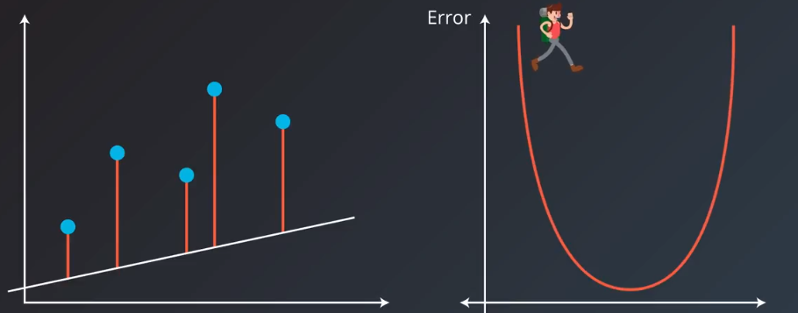
Gradient Descent

Slide 40
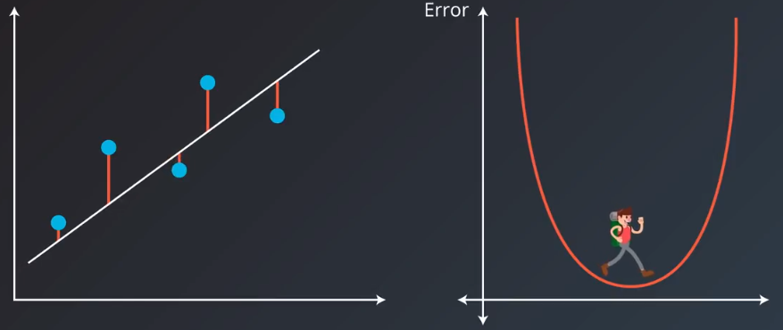
Gradient Descent

Slide 41


Gradient Descent
And this is how to use Linear Regression in python

Slide 42
Linear Regression vs Logisitc Regression

Slide 43
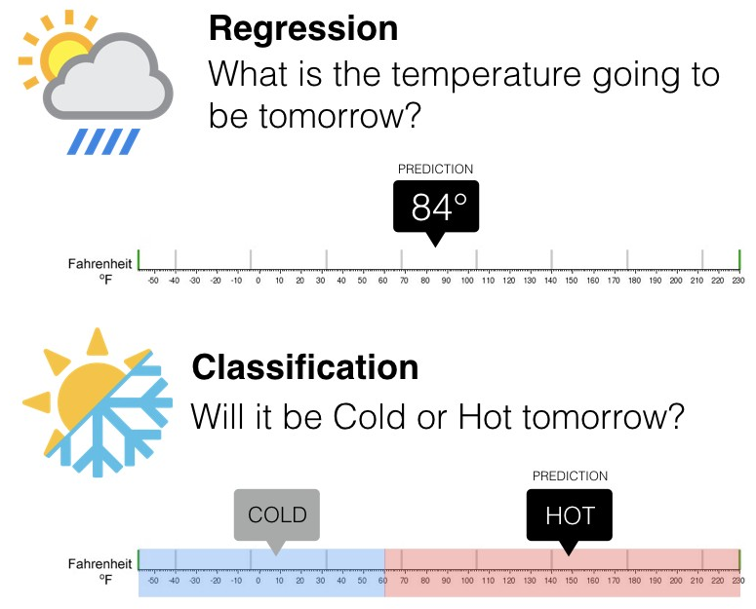
Linear Regression vs Logistic Regression

Slide 44
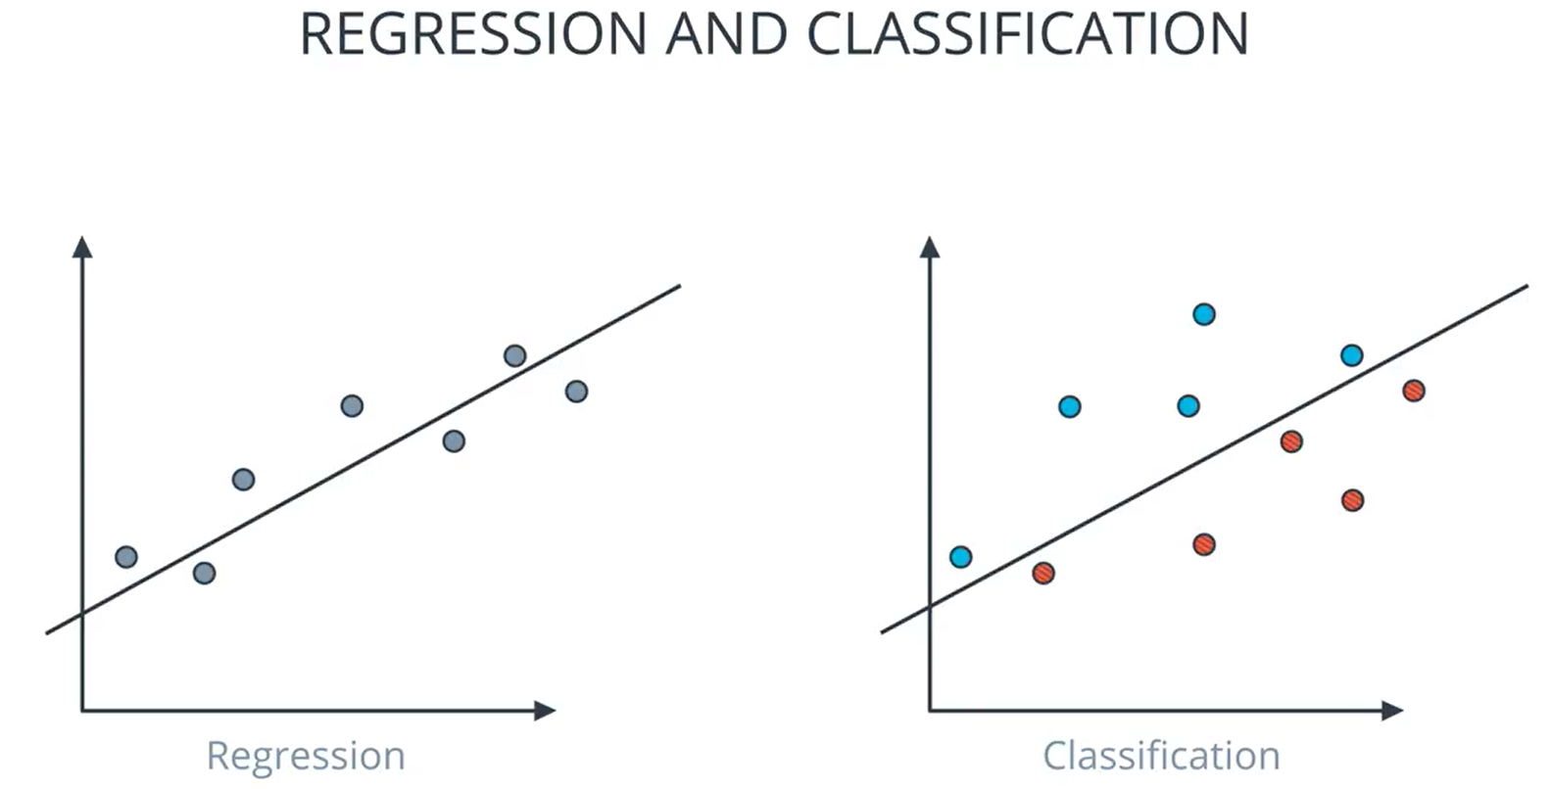
Linear Regression vs Logistic Regression
Regression returns a numeric value
We use Linear Regression
Classification returns a numeric state.
We use Logistic Regression

Slide 45
Any Questions?

Slide 46
Thank You

